Slide 1
Tree Traversal Algorithms
TUAN NGUYEN

Slide 2
Outline
Preorder Traversal
Postorder Traversal
Inorder Traversal of a Binary Tree

Slide 3
Tree Traversal
A traversal of a tree T is a systematic way of accessing, or “visiting,” all the positions of T.
Several common traversal schemes for trees.
Several common applications of tree traversals.

Slide 4
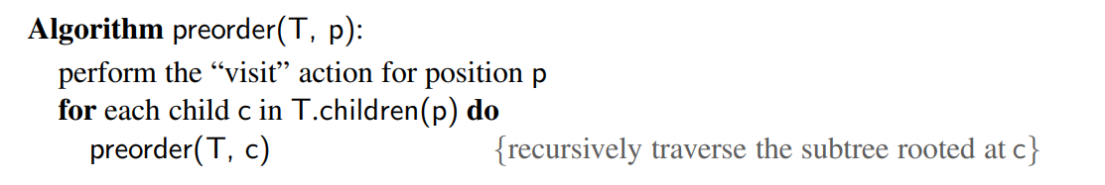
Preorder Traversal
In a preorder traversal of a tree T , the root of T is visited first and then the subtrees rooted at its children are traversed recursively.

Slide 5
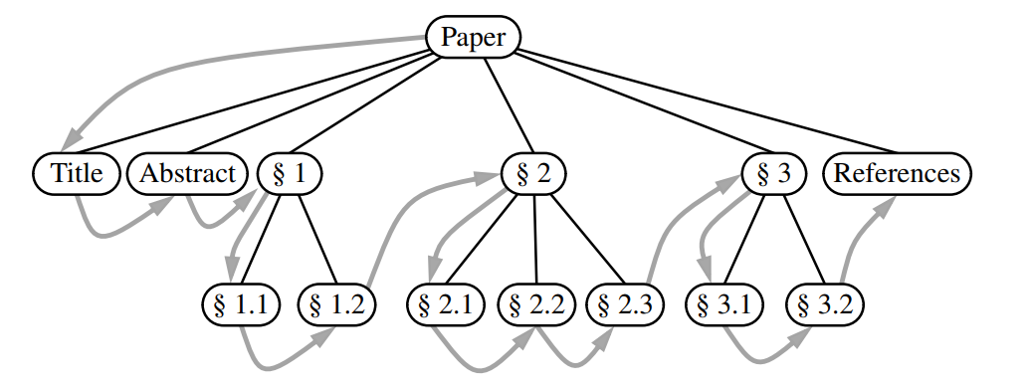
Preorder Traversal (1)

Slide 6
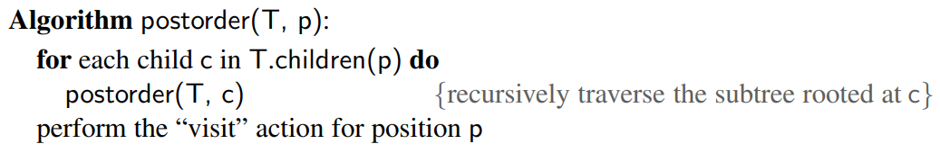
Postorder Traversal
It recursively traverses the subtrees rooted at the children of the root first, and
then visits the root.

Slide 7
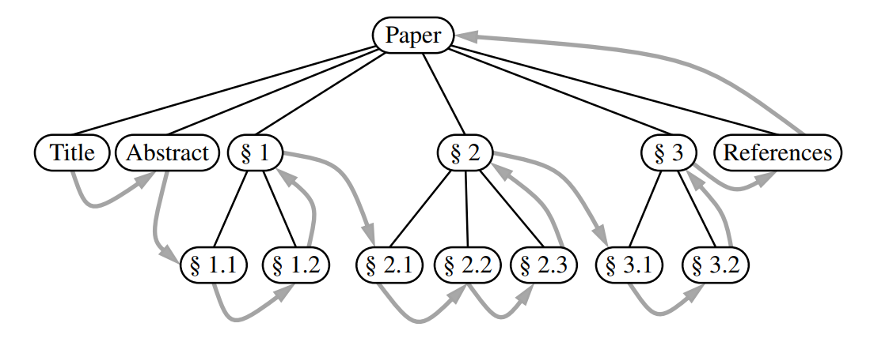
Postorder Traversal (1)

Slide 8
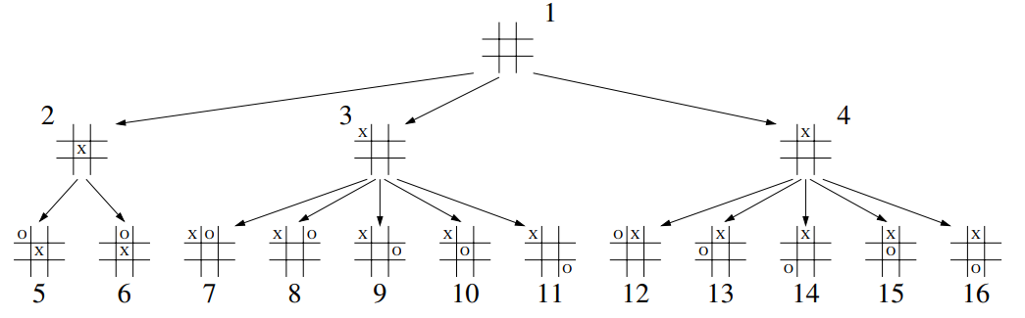
Breadth-First Tree Traversal
Breadth-first traversal algorithm visits all the positions at depth d before we visit the positions at depth d + 1

Slide 9
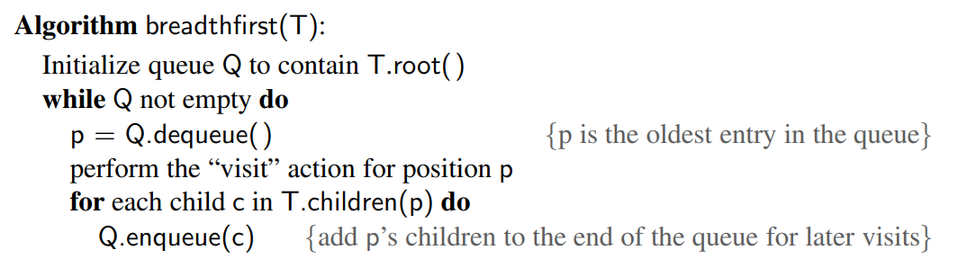
Breadth-First Tree Traversal

Slide 10
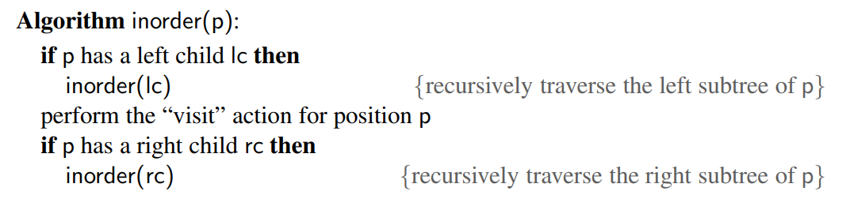
Inorder Traversal of a Binary Tree
The inorder traversal of a binary tree T can be informally viewed as visiting the nodes of T “from left to right.”

Slide 11
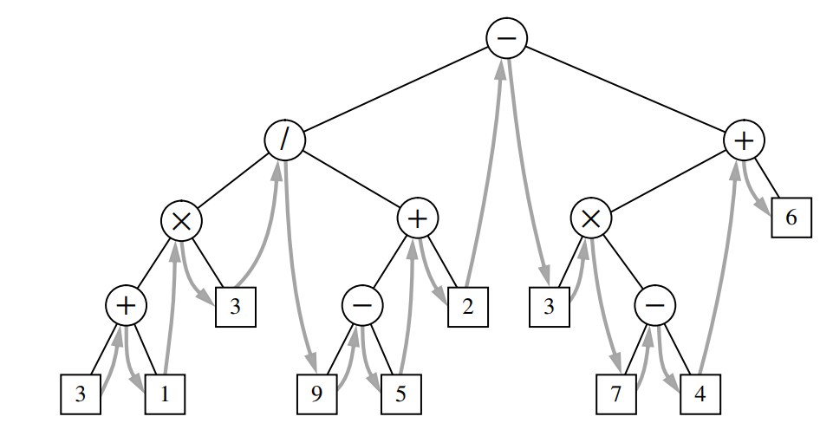
Inorder Traversal of a Binary Tree (1)

Slide 12
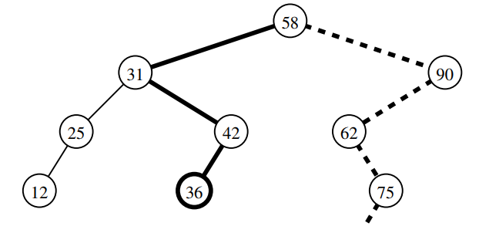
Binary Search Tree
A binary search tree for S is a binary tree T such that, for each position p of T :
Position p stores an element of S, denoted as e(p).
Elements stored in the left subtree of p (if any) are less than e(p).
Elements stored in the right subtree of p (if any) are greater than e(p)

Slide 13
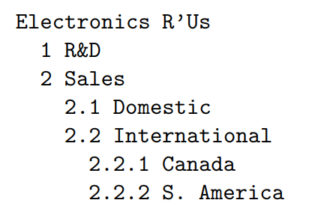
Example: Table of Contents

